Slide 1
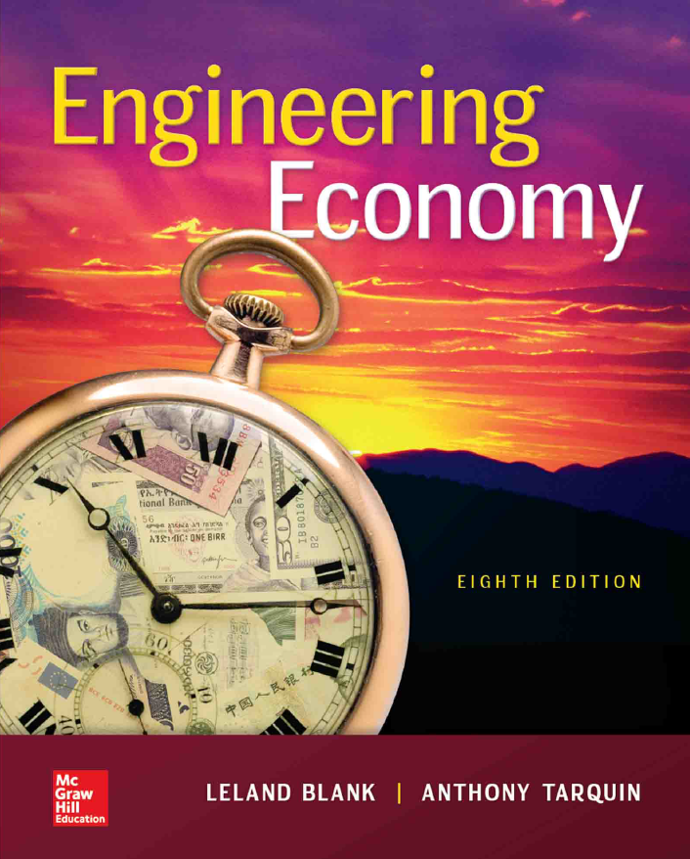

Chapter 7
Rate of Return One Project
Lecture slides to accompany
Engineering Economy
8th edition
Leland Blank
Anthony Tarquin
7-<number>

Slide 2
LEARNING OUTCOMES
Understand meaning of ROR
Calculate ROR for cash flow series
Understand difficulties of ROR
Determine multiple ROR values
Calculate External ROR (EROR)
Calculate r and i for bonds
7-<number>

Slide 3
Interpretation of ROR
Rate paid on ____________ balance of borrowed money such that final payment brings balance to exactly ______ with interest considered
ROR equation can be written in terms of PW, AW, or FW
Use trial and error solution by factor or __________
7-<number>

Slide 4
ROR Calculation and Project Evaluation
To determine ROR, find the i* value in the relation
PW = __ or AW = __ or FW = __
Alternatively, a relation like the following finds i*
PW_{outflow} = PW_{inflow}
For evaluation, a project is economically viable if
i* ≥ ________
7-<number>

Slide 5
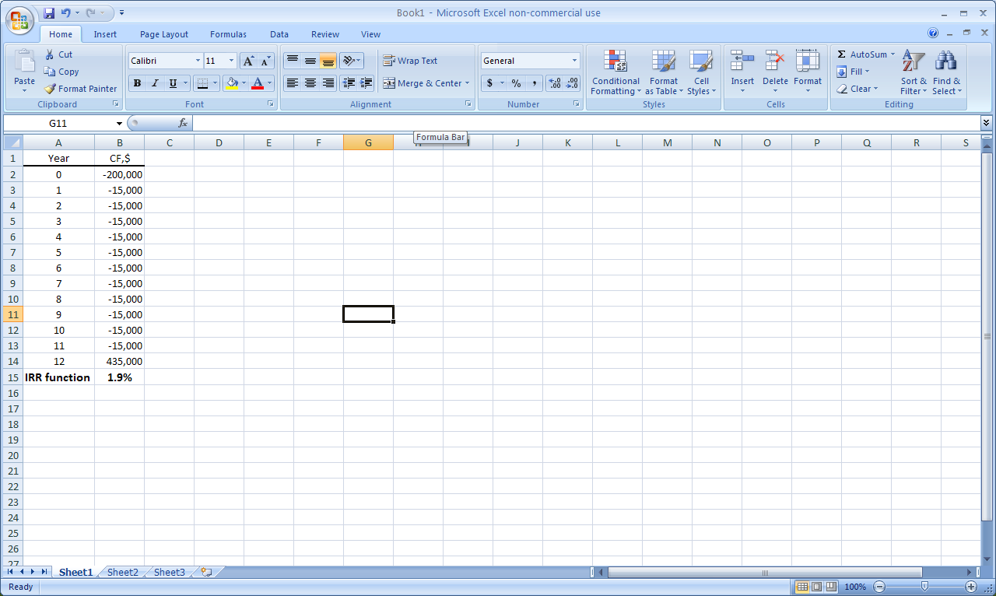
Finding ROR by Spreadsheet Function
Using the RATE function
= RATE(n,A,P,F)
P = $-200,000 A = $-15,000
n = 12 F = $435,000
Function is
= RATE(12,-15000,-200000,______)
Display is i* = 1.9%
Using the IRR function
= IRR(first_cell, last_cell)
= IRR(B2:B14)
7-<number>

Slide 6
ROR Calculation Using PW, FW or AW Relation
ROR is the unique i* rate at which a PW, FW, or AW relation equals exactly __
Example: An investment of $20,000 in new equipment will generate income of $7000 per year for 3 years, at which time the machine can be sold for an estimated $8000. If the company’s MARR is 15% per year, should it buy the machine?
Solution:: The ROR equation, based on a PW relation, is:
__ = -20,000 + 7000(P/A,i*,3) + 8000(P/F,i*,3)
Solve for i* by trial and error or spreadsheet: i* = 18.2% per year
Since i* __ MARR = 15%, the company should buy the machine
7-<number>

Slide 7
Special Considerations for ROR
May get __________ i* values (discussed later)
_________ analysis necessary for multiple
alternative evaluations (discussed later)
7-<number>

Slide 8
Multiple ROR Values
Multiple i* values may exist when there is ____ ____ one sign
change in net cash flow (CF) series.
Such CF series are called ______-conventional
Two tests for _________ i* values:
Descarte’s rule of signs: total number of real i* values
is ≤ the number of sign changes in net cash flow series.
Norstrom’s criterion: if the __________ cash flow starts off negatively and has only ___ sign change, there is one positive root .
7-<number>

Slide 9
Multiple ROR Values
Multiple i* values may exist when there is more than one sign
change in net cash flow (CF) series.
Such CF series are called non-conventional
Three _______ conditions for multiple i* values:
Starts off ____________
Has only _____ _____ _________
∑ __________ cash flow ≥ ∑ ___________ Cash Flow
7-<number>

Slide 10
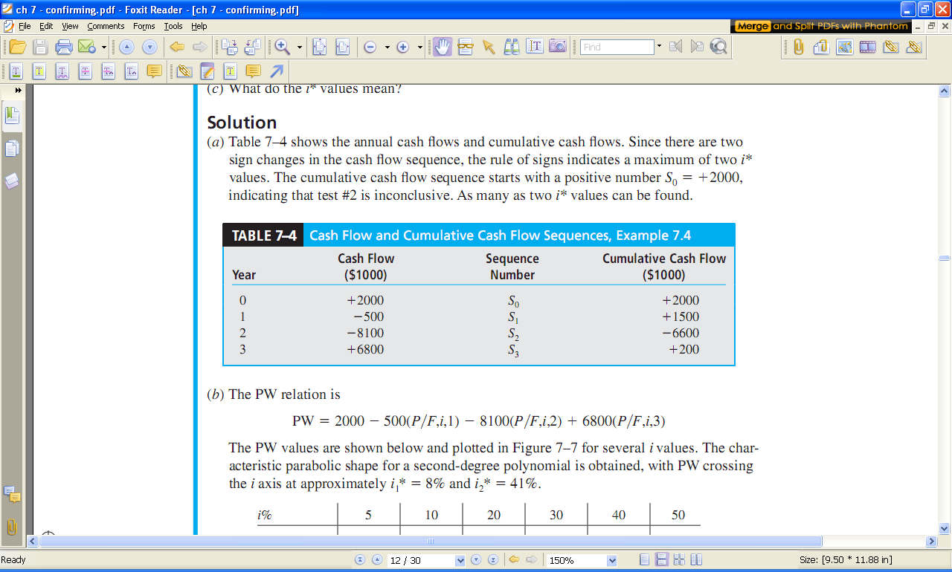
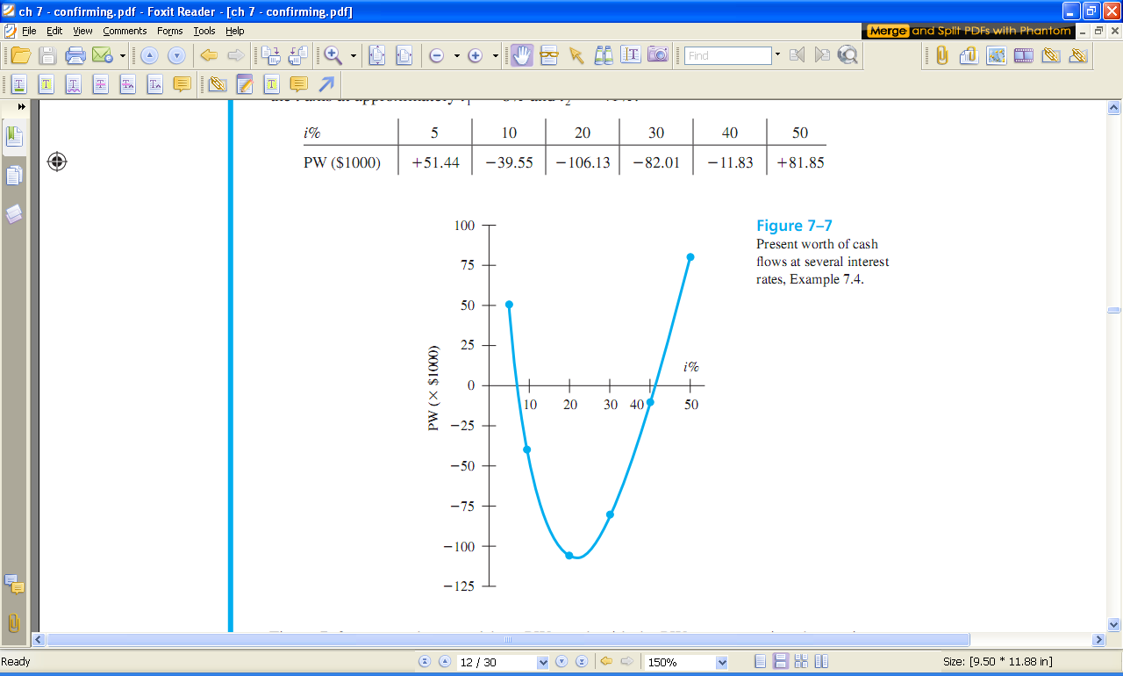
Plot of PW for CF Series with Multiple ROR Values
i* values at ~8% and ~41%
7-<number>

Slide 11
Example: Multiple i* Values
Determine the maximum number of i* values for the cash flow shown below
Year Expense Income
Net cash flow
Cumulative CF
0 -12,000 -
-12,000
-12,000
1 -5,000 + 3,000
-2,000
-14,000
2 -6,000 +9,000
+3,000
-11,000
3 -7,000 +15,000
+8,000
-3,000
4 -8,000 +16,000
+8,000
+5,000
5 -9,000 +8,000
-1,000
+4,000
Solution:
The sign on the net cash flow changes
twice, indicating ___ possible i* values
The cumulative cash flow begins
negatively with ____ sign change
Therefore, there is only one i* value ( i* = 8.7%) > 0
7-<number>

Slide 12
Removing Multiple i* Values
Two new interest rates to consider:
Investment rate i_{i} – rate at which extra funds
are _________ external to the project
Borrowing rate i_{b} – rate at which funds are
_________ from an external source to provide
funds to the project
Two approaches to determine External ROR (EROR)
(1) Modified ROR (MIRR)
(2) Return on Invested Capital (ROIC)
7-<number>

Slide 13
Modified ROR Approach (MIRR)
Four step Procedure:
Determine PW in year 0 of all negative CF at __
Determine FW in year n of all positive CF at __
Calculate EROR = i’ by FW = PW(F/P,i’,n)
If i’ ≥ ______, project is economically justified
7-<number>

Slide 14
Example: EROR Using MIRR Method
For the NCF shown below, find the EROR by the MIRR method if
MARR = 9%, i_{b} = 8.5%, and i_{i} = 12%
Year 0 1 2 3
NCF +2000 -500 -8100 +6800
Solution:
PW₀ = -500(P/F,8.5%,1) - 8100(P/F,8.5%,2)
= $-7342
FW₃ = 2000(F/P,12%,3) + 6800
= $9610
PW₀(F/P,i’,3) + FW₃ = 0
-7342(1 + i’)³ + 9610 = 0
i’ = 0.939 (9.39%)
Since i’ > MARR of 9%, project is _________
7-<number>

Slide 15
Return on Invested Capital Approach
Measure of how effectively project uses funds that remain internal to project
ROIC rate, i’’, is determined using net-investment procedure
Three step Procedure
(1) Develop series of FW relations for each year t using:
F_{t} = F_{t-1}(1 + k) + NCF_{t}
where: k = i_{i} if F_{t-1} > 0 and k = i’’ if F_{t-1} < 0
(2) Set future worth relation for last year n equal to 0 (i.e., F_{n}= 0); solve for i’’
(3) If i’’ ≥ MARR, project is _____ ; otherwise, ________
7-<number>

Slide 16
ROIC Example
For the NCF shown below, find the EROR by the ROIC method if
MARR = 9% and i_{i} = 12%
Year 0 1 2 3
NCF +2000 -500 -8100 +6800
Solution:
Year 0: F₀ = $+2000 F₀ > 0; invest in year 1 at i_{i} = 12%
Year 1: F₁ = 2000(1.12) - 500 = $+1740 F₁ > 0; invest in year 2 at i_{i} = 12%
Year 2: F₂ = 1740(1.12) - 8100 = $-6151 F₂ < 0; use i’’ for year 3
Year 3: F₃ = -6151(1 + i’’) + 6800 Set F₃ = 0 and solve for i’’
-6151(1 + i’’) + 6800 = 0
i’’= 10.55%
Since i’’ > MARR of 9%, project is _________
7-<number>

Slide 17
Important Points to Remember
About the computation of an EROR value
EROR values are dependent upon the
selected investment and/or borrowing rates
Commonly, multiple i* rates, i’ from _____ and
i’’ from ____ have different values
About the method used to decide
For a definitive economic decision, set the
MARR value and use the ___ or ___ method
to determine economic viability of the project
7-<number>

Slide 18
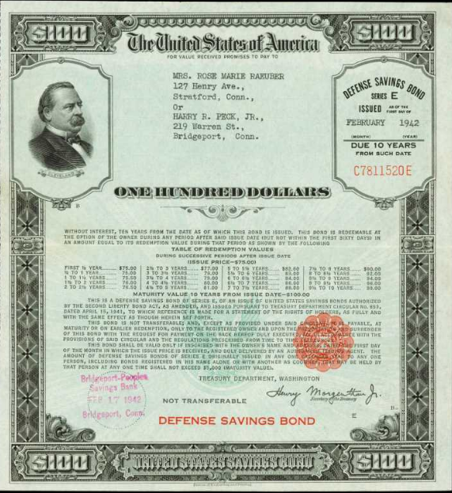
U.S. Saving Bonds
Bond is IOU with face value (V), coupon rate (b),
no. of payment periods/year (c), dividend (I),
and maturity date (n).
V
n
b, c, I
1-<number>

Slide 19
ROR of Bond Investment
Bond is IOU with ___ value (V), _______ rate (b), no. of payment periods/year (c),
________ (I), and ____________ date (n). Amount paid for the bond is P.
I = Vb/c
General equation for i*: 0 = - P + I(P/A,i*,nxc) + V(P/F,i*,nxc)
A $10,000 bond with 6% interest payable quarterly is purchased for $8000.
If the bond matures in 5 years, what is the ROR (a) per quarter, (b) per year?
Solution:
(a) I = 10,000(0.06)/4 = $150 per quarter
ROR equation is: 0 = -8000 + 150(P/A,i*,20) + 10,000(P/F,i*,20)
By trial and error or spreadsheet: i* = 2.8% per quarter
(b) Nominal i* per year = 2.8(4) = 11.2% per year
Effective i* per year = (1 + 0.028)⁴ – 1 = 11.7% per year
7-<number>

Slide 20
Summary of Important Points
ROR equations can be written in terms of PW, FW, or AW and
usually require trial and error solution
i* assumes reinvestment of positive cash flows at i* rate
__________1 sign change in NCF may cause multiple i* values
Descarte’s rule of signs and Norstrom’s criterion (__ ________conditions)
useful when ________ i* values are suspected
EROR can be calculated using ____ or ____ approach. Assumptions about investment and borrowing rates is required.
General ROR equation for bonds is
0 = - P + I(P/A,i*,nxc) + V(P/F,i*,nxc)
7-<number>

Slide 21
HOMEWORK
Please solve every Examples in your textbook. You do not have to submit your works.
Please upload following “PROBLEMS” solution file on “Assignment” menu in e-Class.
  7.12
  7.22
  7.52
  7.71
4-<number>

